Slide 1
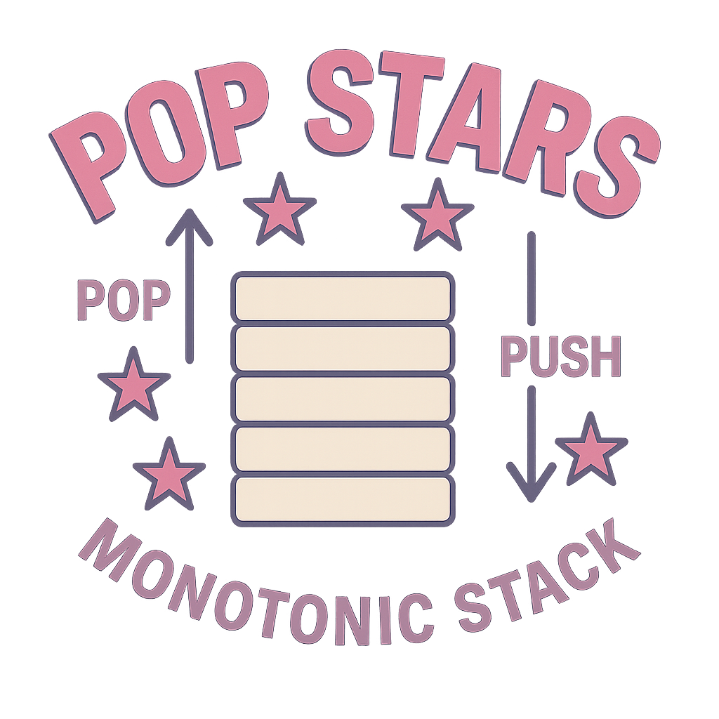
Monotonic Stack
CS5008 Project
Rita He, Jingjing Pan, Ziye Huang, Melody Li, Jasmine Guo

Slide 2
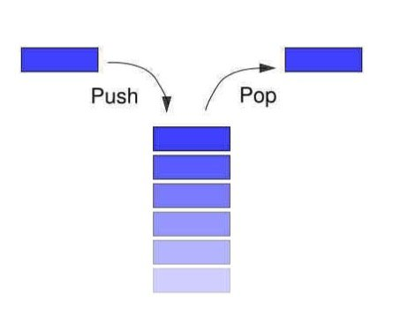
Monotonic Stack Introduction
Classical Examples
Real World Applications

Slide 3
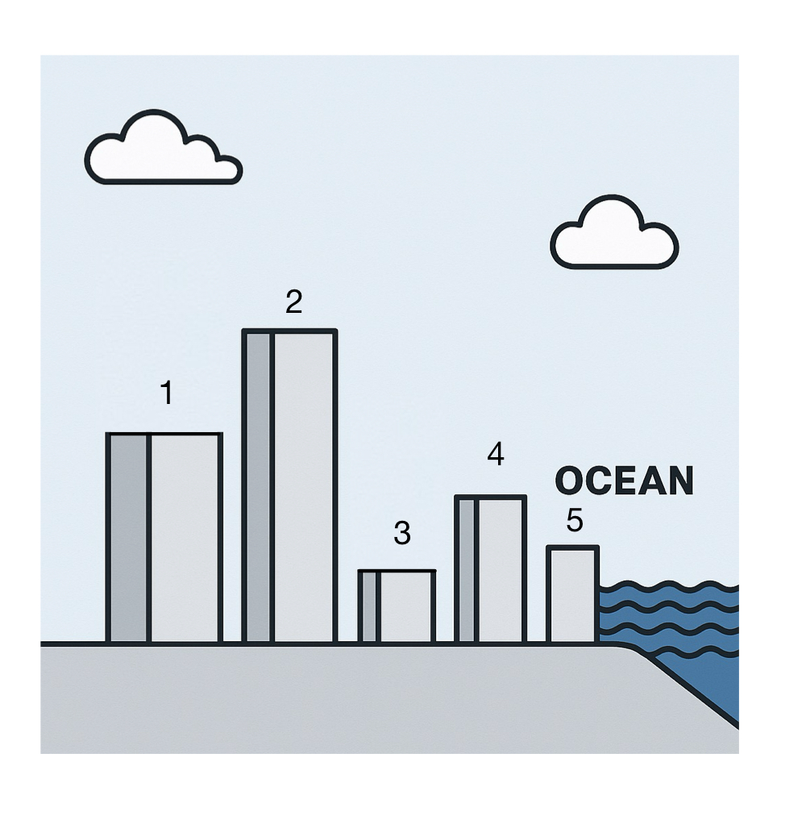
Which building would you choose to live in?

Slide 4
How do we find the ocean view buildings?
Remove shorter buildings
Keep the buildings with ocean view
Maintain a decreasing sequence of heights
Monotonic Stack

Slide 5
What is a Monotonic Stack?
✔ stack (LIFO structure)
✔ order

Slide 6
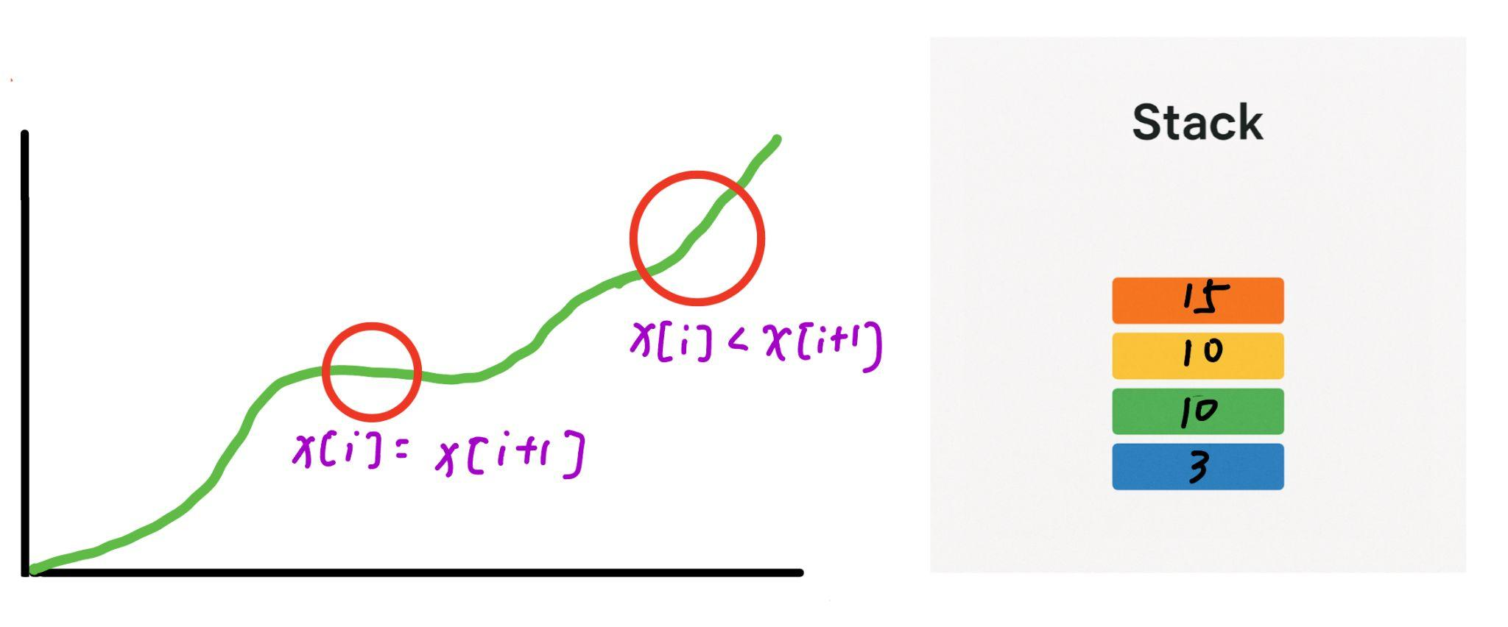
Monotonically Increasing Stack (Largest on top)

Slide 7
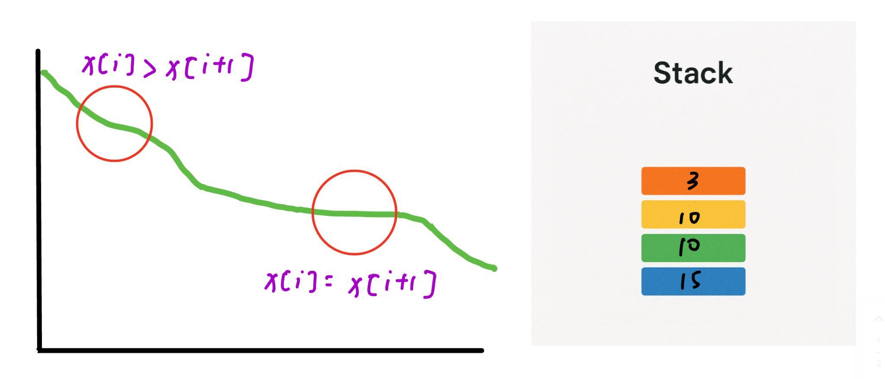
Monotonically Decreasing Stack (Smallest on top)

Slide 8
Key Insights
✔ Monotonic stacks help maintain order efficiently
✔ Useful for “next/previous smaller/larger element” problems

Slide 9
Given an array heights = [2, 1, 4, 5, 3], for each element, find the nearest smaller height to its left. If no such value exists, return -1 for that position. Return the result as an array of the same length.
Answer: [ ]
-1,
-1,
1,
4,
1
5
3
4
1
Time Complexity: O(n)
Space complexity: O(n)
2
L ➡️ R : Monotonically Increasing Stack

Slide 10
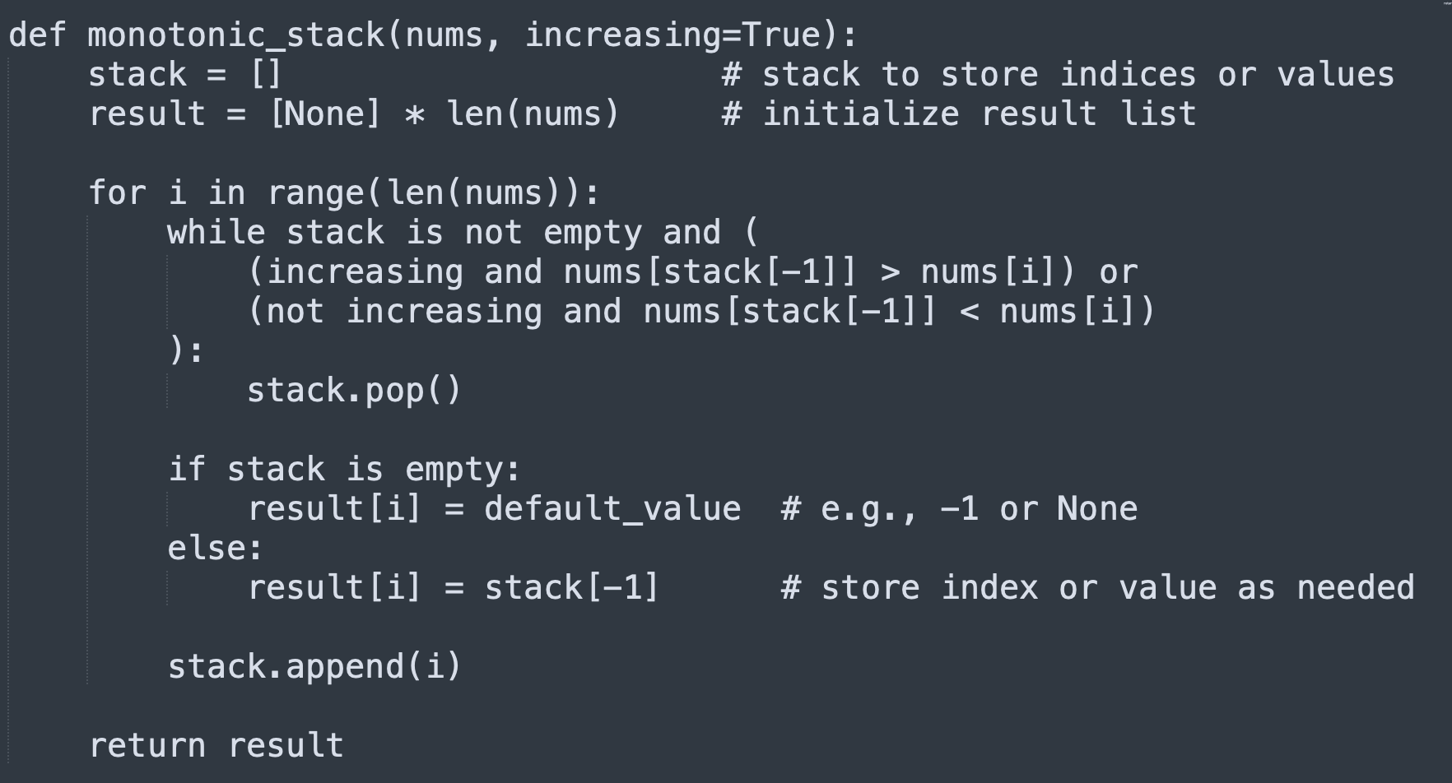
Pseudocode

Slide 11
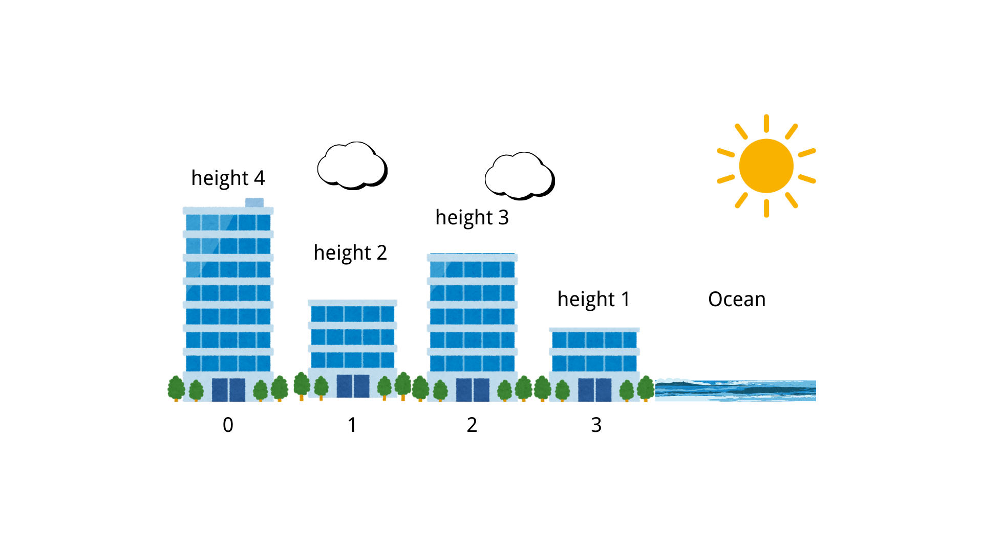
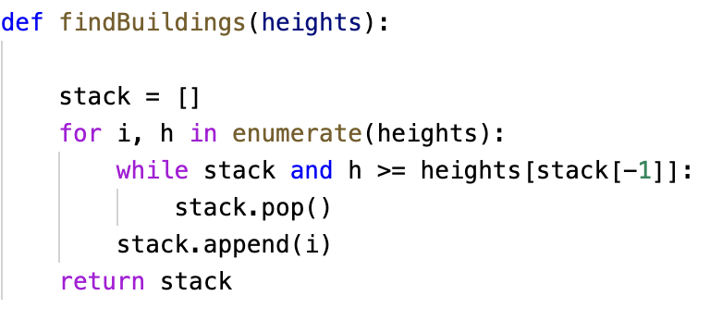
Ocean View
Time-Complexity: O(N)
Find all the building with ocean views
A building can see the ocean as long as every building to its right is shorter.
1
2
3
4

Slide 12
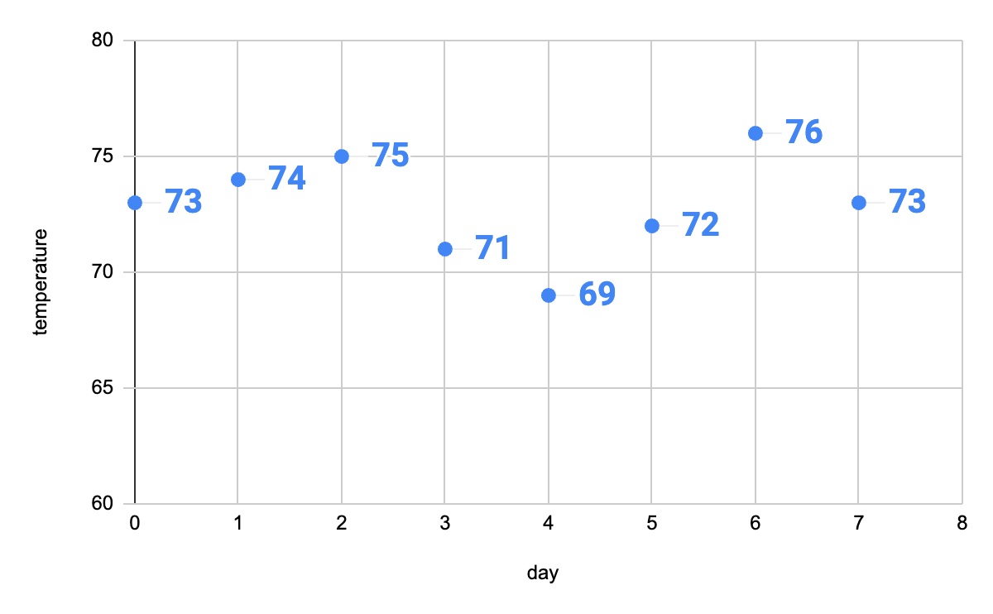
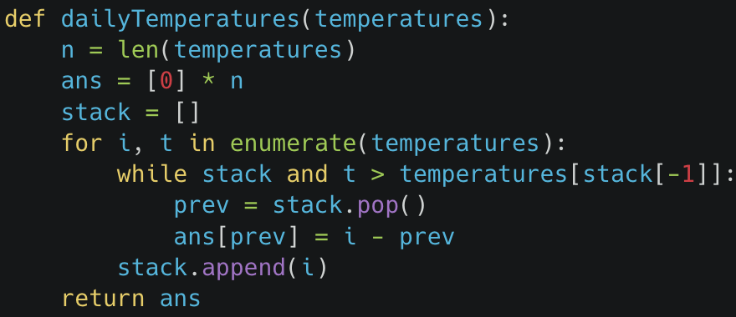
Daily Temperatures
Given an array of integers temperatures represents the daily temperatures, return an array answer such that answer[i] is the number of days you have to wait after the i-th day to get a warmer temperature. If there is no future day for which this is possible, keep answer[i] = 0.
Monotonic decreasing stack
4, 69
3, 71
5, 72
7, 73
0, 73
1, 74
2, 75
6, 76

Slide 13


Applications
Browser History Management
Network Traffic Analysis

Slide 14


Browser History Management
Monotonicity of Time：browser access maintains a time order that should be preserved
Back stack: stores the pages which are firstly visited before the current page
Forward stack: stores pages which are visited after the current page
Browser History Management
Network Traffic Analysis

Slide 15

Browser history management
Browser History Management
Network Traffic Analysis
Visit New Page:
Push the current page onto the back stack
Clear the forward stack
Set the new page as the current page
Browser
Page B
Page D
Page A
Page C
Go Back:
Push the current page onto the forward stack
Pop the top page from the back stack as the new current page
C
B
C
A
D
Go Forward:
Push the current page onto the back stack
Pop the top page from the forward stack as the new current page
back stack
forward stack
back
forward

Slide 16

Network Traffic Analysis
Browser History Management
Network Traffic Analysis
Application Scenario：
Network administrators need to monitor network traffic patterns.
Key Challenge：
How to quickly identify pattern change points?
Monotonic Stack Solution：
Maintain a monotonic stack representing the traffic trend.
When traffic data violates the current trend, mark it as a change point.

Slide 17
Thank You!

